Slide 1
UDL: Addressing the Variability of All Learners in Writing Workshop and Storytelling
April 2, 2014

Slide 2
Goals and Next Steps
Understand UDL Concepts and Guidelines
Apply UDL to Writer’s Workshop and Storytelling
Notes:
Understand the concepts and guidelines of Universal Design for Learning (UDL)
Understand your assumptions as they relate to UDL assumptions
Post goals on chart paper and periodically throughout the workshop, refer to the goals.

Slide 3
Assumptions and Realities
    Students of Today
    Goals of Instruction
    Curriculum
    Learning
Notes:
Handout
Assumption = a hypothesis, proposition taken for granted, conjecture, accepted cause-effect relationships, gives basis for action
20 minutes – you can have choose to do the following for sharing or you might want to have personal thinking time and then haring with a neighbor.
Pass out colored index cards – assorted colors at each table or grouping
Have participants jot down, draw, collage, make a web of their assumptions about each bullet
Then have participants group by colored index cards, introduce themselves and share their assumptions
TELL PARTICIPANTS TO HOLD ONTO THEIR CARDS AS WE WILL CONTINUE TO REFERENCE BACK TO THIS

Slide 4
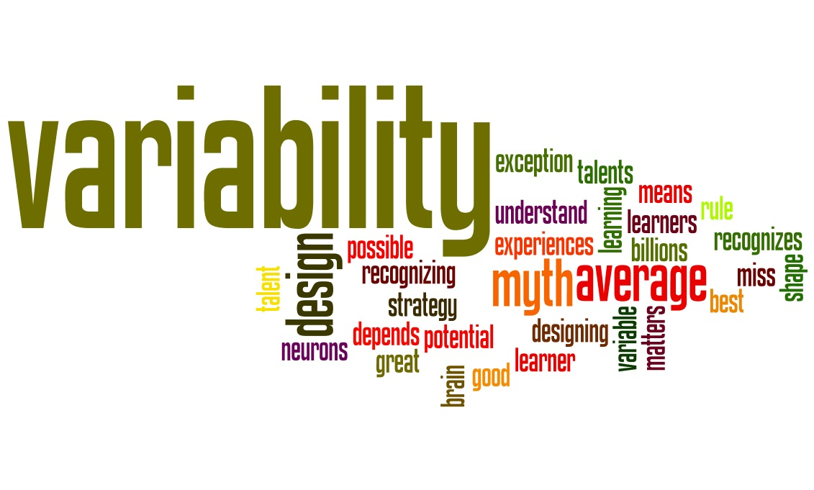

Variability matters!
Think about your classes and learner variability

Slide 5
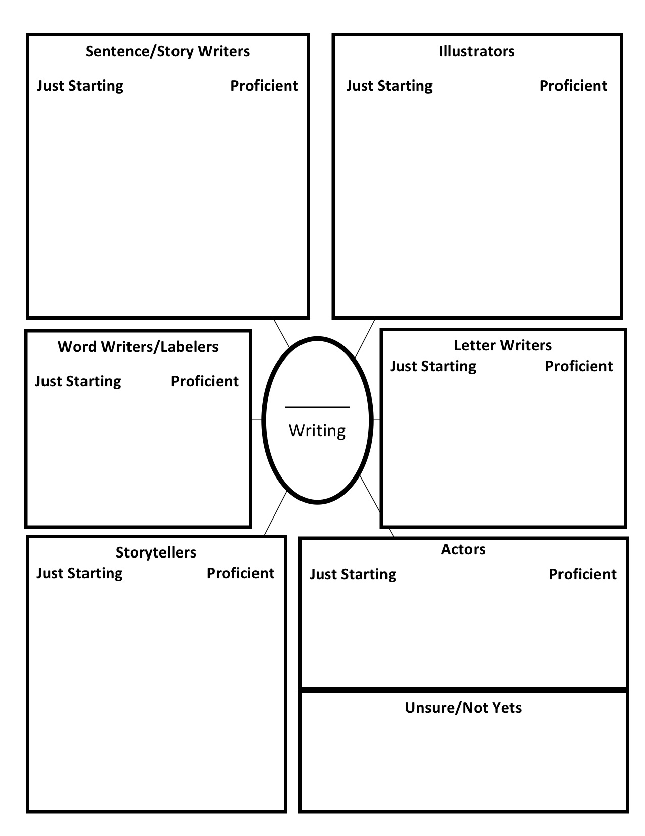
Variability of Your Learners

Slide 6
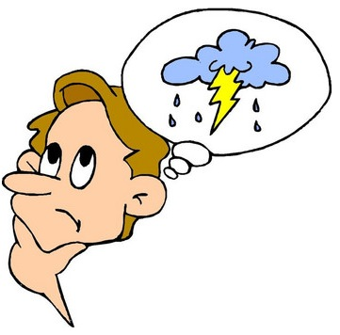
What is Universal Design for Learning? UDL…
is framework for designing curricula that enable all individuals to gain knowledge, skills, and enthusiasm for learning.
provides rich supports for learning and reduces barriers to the curriculum while maintaining high achievement standards for all.
recognizes variability as the norm.
Notes:
This is the beginning of reinforcing the concept that UDL is a framework for designing curriculum. You might like to note that we do not view UDL as another initiative, but rather a framework for thinking about and aligning other initiatives. Also, in your presentation of this concept, you might reinforce the idea that we want to enable all learners to gain knowledge, skills, and enthusiasm for learning. This message will be repeated in later sessions in which we present the three networks of recognition, strategic, and affective.

Slide 7
UDL Assumptions
Learners in any classroom represent a range of variability
The goal of instruction is to develop “expert learners”
Curriculum needs to reflect the variability of all learners
Learning occurs in the dynamic interaction of the individual with the environment
Notes:
Introduce the UDL assumptions
After recognizing personal assumptions, we are now ready to highlight prevailing UDL assumptions.
Present the UDL assumptions and then deconstruct these in the following slides.

Slide 8
UDL Assumptions
“Expert Learners”
Strategic, goal-directed learners.
Resourceful, knowledgeable learners.
Purposeful, motivated learners.

Slide 9
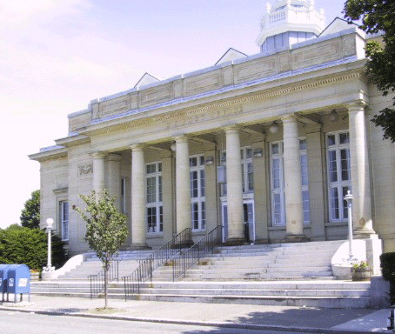
Universal Design … an example of change

Slide 10
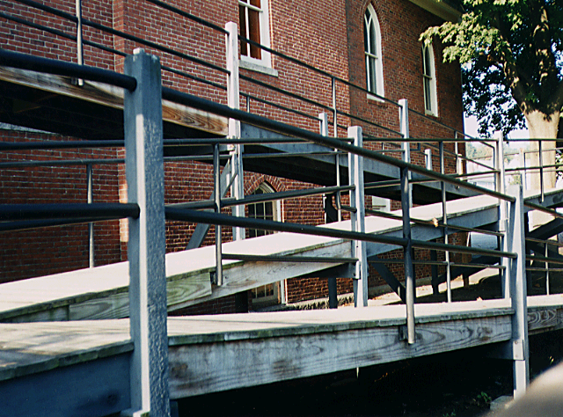
Universal Design … an example of change…retrofitting
Notes:
Drawbacks of Retrofitting:
Each retrofit solves only one local problem
Retrofitting can be costly
Many retrofits are UGLY!

Slide 11
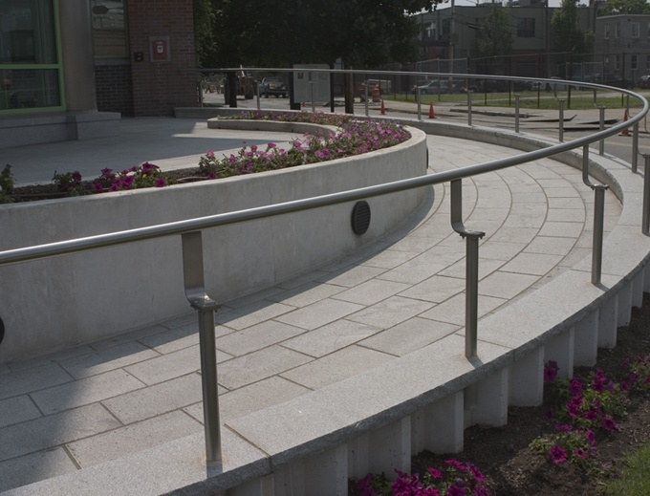
UD- A Conceptual Shift
  “Consider the needs of the broadest possible range of users from the beginning”
-- Architect, Ron Mace

Slide 12
UD Assumptions
Not one size fits all – but alternatives for everyone.
Not added on later – but designed from the beginning.
Not access for some – but access for everyone.
Notes:
Intro to udl
History of beginnings of cast, subject dear to my heart
Early 80’s, hospital ---a lot of time and effort not much result, kids not active/passive recipients. Computers for us, productivity, idea of giving tools
Started out with LD focus – WP with spell check, the ideas important, not the mechanics, depending upon the goal. Tools to scaffold areas of weakness and put learning where it ought to be, at the point of cognitive challenge.
At first, used applications such as WP’s and drawing programs, ed software, then with scanner and authoring tools, making digital versions of test, digital books, embedding supports for different kids – matt, mason, megan -- Multiple clients, different digital books – then realized, why not make one with options behind the main page, if you need X you can have it, if not, it is not in the way. Text could read aloud, be shown any size and color, options could scan sequentially on the screen so users could control screen with single switch –
This was the beginning of a Copernican shift for us in our thinking: the barriers to learning for students with disabilities lay not in the students but in the curriculum itself – in fact, many disabilities occur only in the intersection between the learner and the methods and materials available for learning – with flexible and appropriate materials and methods, the student is a learner like any other.

Slide 13
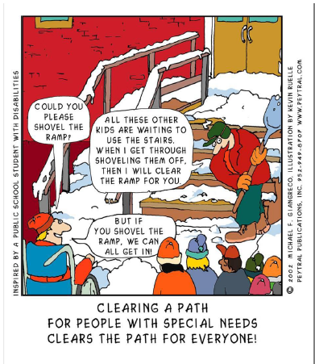
UD Assumptions
Notes:
Intro to udl
History of beginnings of cast, subject dear to my heart
Early 80’s, hospital ---a lot of time and effort not much result, kids not active/passive recipients. Computers for us, productivity, idea of giving tools
Started out with LD focus – WP with spell check, the ideas important, not the mechanics, depending upon the goal. Tools to scaffold areas of weakness and put learning where it ought to be, at the point of cognitive challenge.
At first, used applications such as WP’s and drawing programs, ed software, then with scanner and authoring tools, making digital versions of test, digital books, embedding supports for different kids – matt, mason, megan -- Multiple clients, different digital books – then realized, why not make one with options behind the main page, if you need X you can have it, if not, it is not in the way. Text could read aloud, be shown any size and color, options could scan sequentially on the screen so users could control screen with single switch –
This was the beginning of a Copernican shift for us in our thinking: the barriers to learning for students with disabilities lay not in the students but in the curriculum itself – in fact, many disabilities occur only in the intersection between the learner and the methods and materials available for learning – with flexible and appropriate materials and methods, the student is a learner like any other.

Slide 14
Variability matters! http://www.youtube.com/watch?v=8WClnVjCEVM

Slide 15

How do these ideas relate to what is going on in our classrooms today?

Slide 16
Writer’s Workshop
Writing Mini Lesson and/or read aloud of a mentor text focusing on the writer’s/illustrator’s craft to be explored.
Storytelling/Drawing/Writing: Children engage in independent drawing/writing and teacher conferences with the writers.
Story of the Day: Whole group interactive writing and sharing.

Slide 17
BPS Writing Guide

Slide 18
Storytelling
Modeling Storytelling (Adult Stories) Engaging stories to Share with your class
Children’s Storytelling (Dictation) Dictating with a child and Sharing with an audience
Story Acting (Dramatization) Acting out the story with actors and Sharing with an audience

Slide 19
BPS Early Childhood

Slide 20
UD Belief
… “all new environments and products, to the greatest extent possible, should be usable by everyone regardless of their age, ability, or circumstance.”
Retrieved May 6, 2011 from
http://www.ncsu.edu/www/ncsu/design/sod5/cud/about_us/about_us.htm

Slide 21
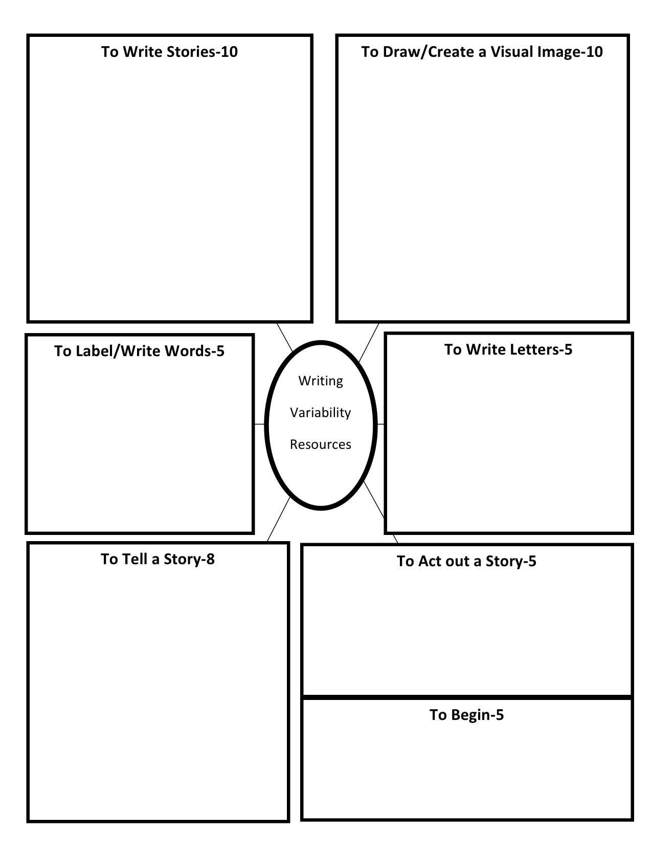
Variability in Instruction

Slide 22
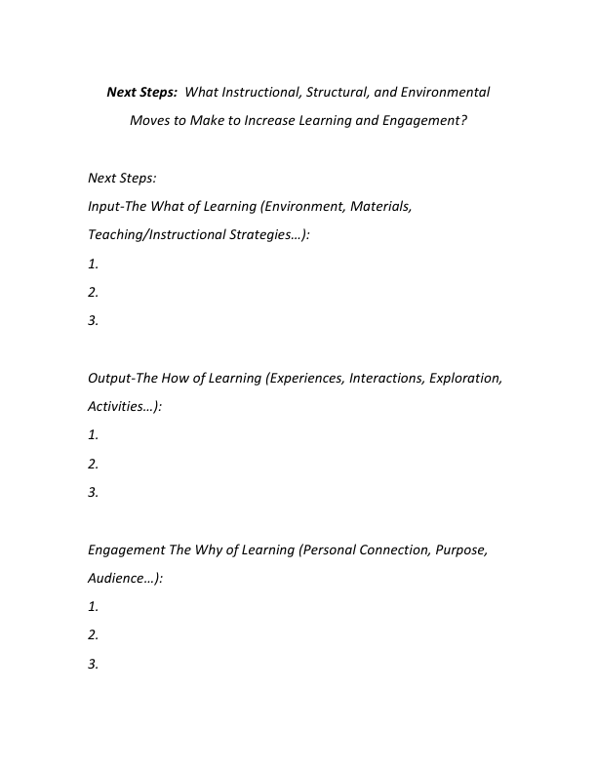
Next Steps

Slide 23
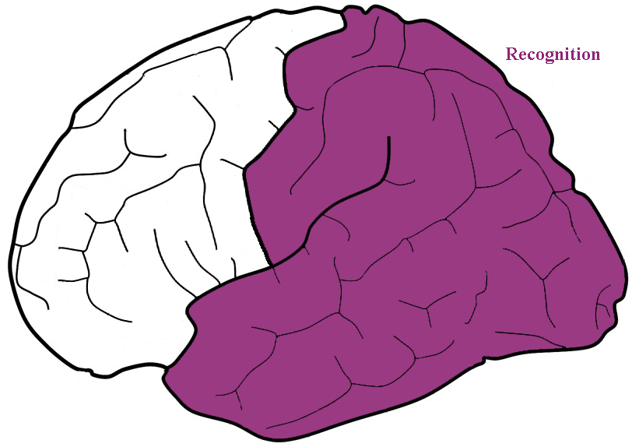
UDL and the Learning Brain
  Recognition Networks: “the what of learning”
    identify and interpret patterns of sound, light, taste, smell, and touch
Notes:
The Recognition Networks, located in the back of the brain, enable us to identify and interpret sound, light, taste, smell, and touch. For example, when you answer the phone and hear a familiar voice you can easily tell who it is without having the person give his/her name. Draw other examples from your understanding of the recognition networks.
In a classroom, the recognition networks are essential to learning; students are expected to identify letters, formulas, maps, ideas, cause/effect relationships, etc. – Ask audience for additional classroom examples of recognition networks at work.
Everyday examples of recognition networks in action include identifying ingredients for recipes, telling the difference between shampoo and shaving cream so you can wash your hair, identifying the smell of freshly cut grass, recognizing the sound of pain or joy, etc.
Note: Play the audio clip and listen to David Rose talk about the recognition network.

Slide 24
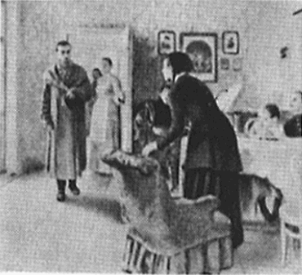

UDL and the Learning Brain
Notes:
Show this slide for 2-3 seconds then hit the back button to return to the previous slide. Then ask participants what they saw in this picture. Stress how amazing it is that although they never saw this image before, they were able to describe/name many things they saw. Also ask whether anyone saw a dog– let them know that their brain is actively trying to make sense of the patterns in the picture. (Some folks think the abstract image to the right of the woman’s skirt is a dog. Reinforce that that is ok, it’s the job osf the recognition network to make sense of what is perceives.)

Slide 25

Recognition: What is this?
Notes:
Let’s try another recognition task – what is this? After a few responses, tell participants that your brain is trying to figure out what this is. The brain is goal directed, either your goals or ones that individuals regard as important.

Slide 26
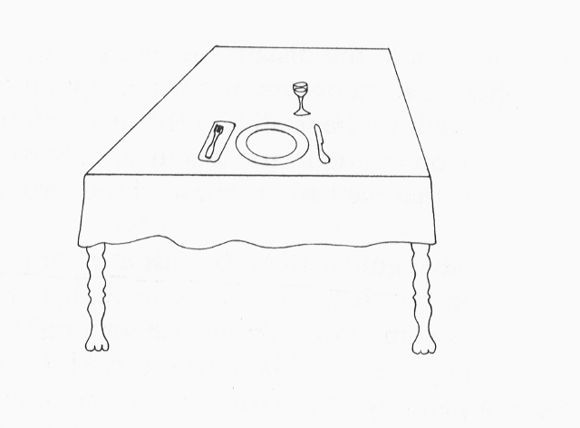
Notes:
When presented in context it is much easier to recognize what it is. What implications does this have for instructional practices? Turn to your neighbor and talk about it.

Slide 27
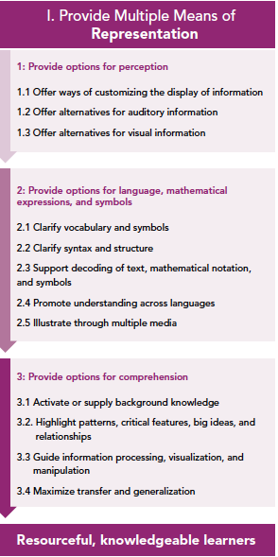
Multiple Means of Representation
Provide Multiple Means of Representation (the “what” of learning)
Perception
  Tell me more: Display information in a flexible format so that the following perceptual features can be varied
Language, expressions, and symbols
    Tell me more: Pre-teach vocabulary, clarify unfamiliar syntax
Comprehension
    Tell me more: Activate background knowledge, highlight critical features
Notes:
Summary slide: From what we have learned from the cognitive and neurosciences science, we have development the UDL principles. Principle 1 is Multiple means of representation. We will talk about the guidelines in greater detail in subsequent sessions.

Slide 28
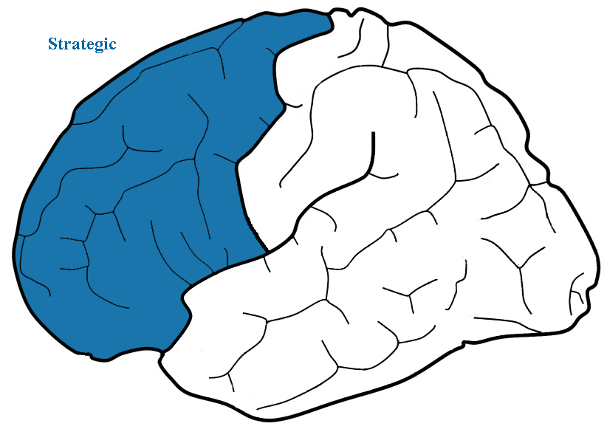
    Strategic Networks:
    “the how of learning”
    Plan, execute, and monitor actions and skills
Notes:
Use the Canter 17 audio file where David is talking about the Strategic network – this will need to be linked to the audio button on this slide.
The strategic networks are located in the front part of the brain and enable us to plan, execute, and monitor actions and skills.
In learning situations, the strategic networks are critical. Examples of the strategic networks at work include: doing a project, taking a test, taking notes, listening to a lecture
They work in tandem with recognition networks to learn to read, compute, write, solve problems, plan and execute compositions and complete projects.
Everyday examples of the strategic networks in action include cooking a meal, planning an outing, executing a golf swing, driving a car, etc.
Note: Play the audio clip and listen to David Rose discuss the strategic network.

Slide 29
What are you looking at when you view this picture?
Notes:
Define executive functions:
Ask participants to look at the picture and think about where they are looking at the picture. And then ask the other questions on the slide. Ask them to think about how they changed strategies. For the first question, they looked at the faces, to answer the second question, they looked all around the image. They changed their strategy based on the purpose of each question.

Slide 30
UDL and the Learning Brain
Look at the picture.
What are the material circumstances of the people?
What are the ages of the people?

Slide 31
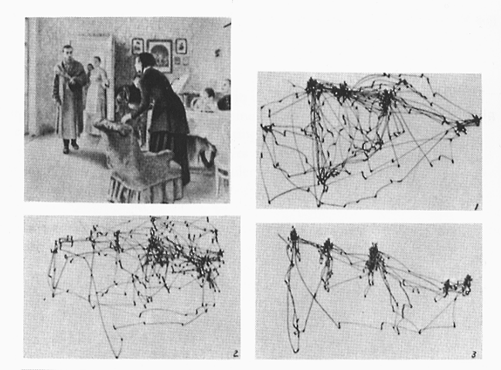
Notes:
Explain that the “Unexpected Visitor” picture was used to study eye gaze of volunteers as they looked at the picture. Ask the participants why the eye gaze images are different. After they have some time to respond tell them that the same person is responding to the image. Ans. Different questions result in different eye gaze strategies. Which slide shows the examiner asking the age of the individuals in the image?

Slide 32
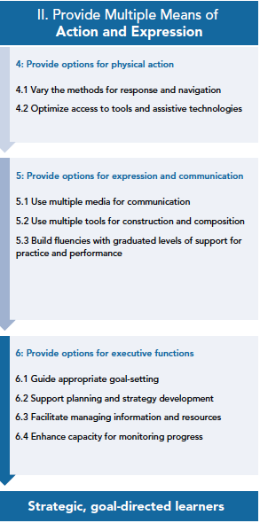
Multiple Means of Action and Expression
  Physical action
    Vary methods of response and optimize use of assistive technology
  Expression and communication
      Use multiple means of communication, build fluencies with gradual levels of support
    Executive function
      Guide goal setting, facilitate management of information, and enhance capacity for monitoring progress
Notes:
Summary slide: From what we have learned from the cognitive and neurosciences science, we have development the UDL principles. Principle 2 is Multiple means of action and expression. We will talk about the guidelines in greater detail in subsequent sessions.
Optional: Gorilla video: attention is driven by expectation: it is important to make goals clear
Can give time to reflect about activities…

Slide 33
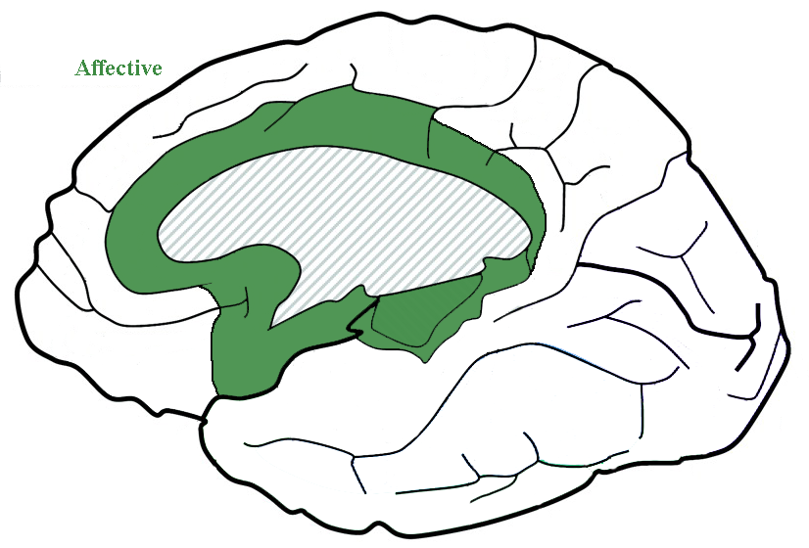
    Affective Networks: “the why of learning”
    Evaluate and set priorities
Notes:
Use the Canter 19 audio file where David is talking about the Affective network – this will need to be linked to the audio button on this slide.
The affective networks are located at the core of the brain and enable us to engage with tasks and influence our motivation to learn. They are responsible for developing preferences and establishing priorities and interests.
In learning situations, affective networks are essential to wanting to learn; visualize a high school classroom, the night before the prom – “Are students’ affective networks helping focus on the algebra lesson or on the party after the prom?” Visualize the student who has had years of reading failure in a 9th grade English class, “Is this student motivated to read The Odyssey?”
Everyday examples of the affective networks in action include being motivated to get up extra early to wrap presents for a child, wanting to run to the grocery store to shop for a special dinner after a busy day at work, being nervous before a business presentation, etc. Of course, the affective network does not work in isolation from either the recognition or strategic networks.
Note: Play the audio clip as David Rose presents information on the affective network.

Slide 34
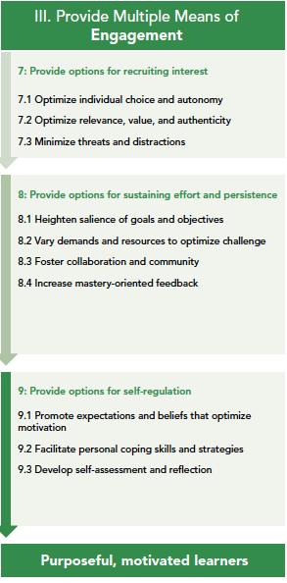
Multiple Means of
Engagement
Recruiting interest
  optimize relevance, optimize choice, and minimize threats
Sustaining effort and persistence
  vary demands, foster collaboration, and increase mastery-oriented feedback
Self regulation
  promote expectations and beliefs, facilitate personal coping skills, and develop self-assessment and reflection
Notes:
Summary slide: From what we have learned from the cognitive and neurosciences science, we have development the UDL principles. Principle 3 is Multiple means of engagement. We will talk about the guidelines in greater detail in subsequent sessions.

Slide 35
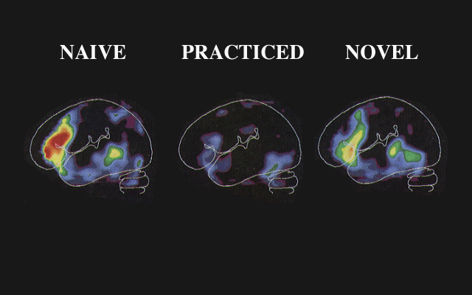
How Do You Provide for Variability Today?
Find those strategies!

Slide 36
In Summary,
UDL is framweork for diseginng cruirucla taht ebnale all ididnvuilas to gain knlowdege, slkils, and enthsuasim for laerinng.
UDL prodives rcih sropptus for leraning and reuedcs briarers to the cruiruclum while minatanniig hgih aihecvemnet stndarads for all.
What a practiced learner can do.

Slide 37
UDL Assumptions
CAST believes that “barriers to learning are not, in fact, inherent in the capacities of learners, but instead arise in learners' interactions with inflexible educational goals, materials, methods, and assessments.”
Teaching Every Student in the Digital Age, p. vi

